Slide 1
Roller Coaster Design Presentation
Roller coasters should be fun and exhilarating but also safe.
For a ride like this to be successful, it should attract attention.
People need to feel safe and secure while still feeling a bit of danger so they still find the ride thrilling.
Notes:
my design philosophy centers around creating an exhilarating yet safe ride. I believe a successful roller coaster should offer a balance of thrill and safety. Those who come to ride it need to have the peace of mind that it is safe, while still allowing their brains to recognize danger. This provides riders with an adrenaline rush which will allow them to enjoy the ride more. Additionally, I believe the attraction should be aesthetically pleasing so that it attracts attention of those in the park.

Slide 2
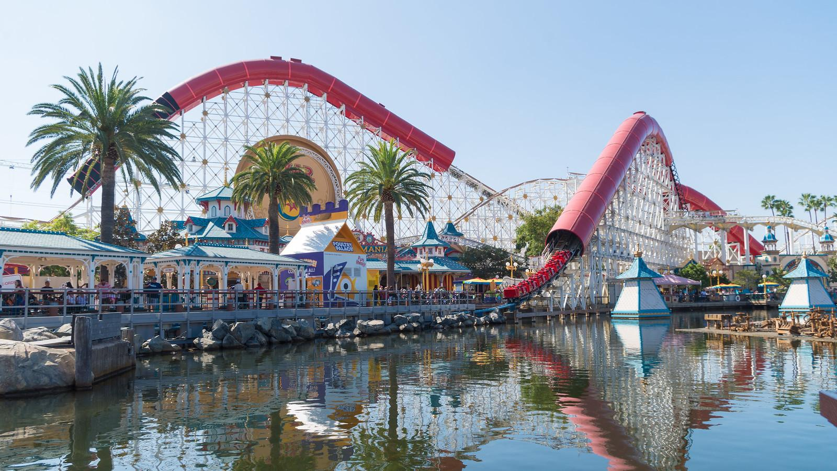
The Incredicoaster
Height of 121 feet
55 mph
One loop and 3 hills
Notes:
My favorite roller coaster is the Incredicoaster at California Adventure which is at Disneyland. It has hills reaching heights of 121 feet. This is not too tall, however, it moves fast. It has one loop and 3 hills as well as a ton of curves. The ride lasts 3 mins which makes the line more than worth it. Its maximum speed is 55 mph, but when you are on it, you feel as if you’re going 100 mph. I think I have realized I prefer fast rollercoasters, but not insanely high. There is a rollercoaster in New Jersey called the Kingda Ka that reaches a height of 456 feet! In my opinion this is far too high, but i know there are some people who enjoy a thrill like that.

Slide 3
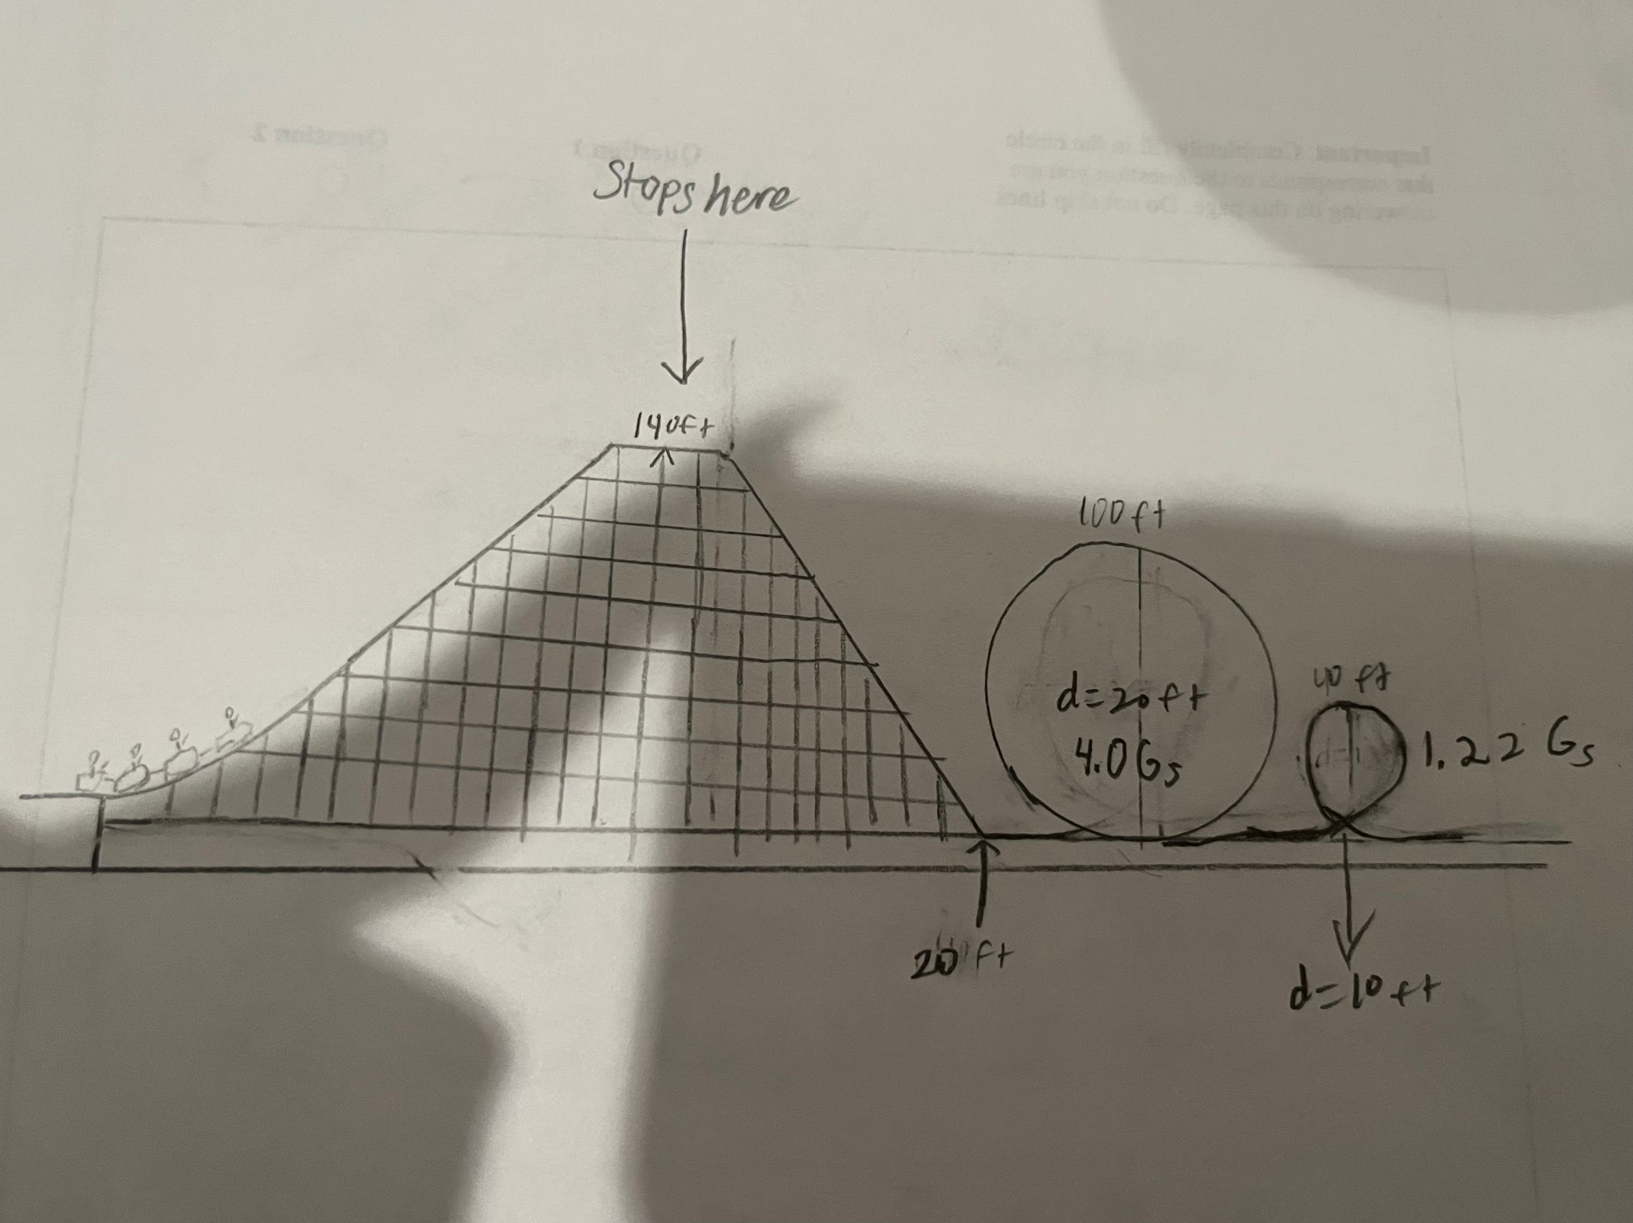
Notes:
Unfortunately, my image would not upload well and it looks a bit distorted. I think you guys can get the idea though. For my design I decided to create one steep hill with a quick drop that goes straight into two loops. Prior to dropping down the hill, the cart stops. This builds anticipation for the rest of the ride. It reaches a maximum height of 140 ft which is the equivalent to 42.672 meters

Slide 4
The chain lift took 10.668 seconds to reach the top of the hill as it was traveling at 4 meters per second.
140ft x .3048 ft/m = 42.672 m
42.672 m / 4 m/s = 10.668 seconds
Notes:
The chain lift took 10.668 seconds to reach the top of the hill as it was traveling at 4 meters per second. The conversion factor to change ft to meters is .3048 ft per meter. 140ft x .3048 ft/m = 42.672 m
42.672 m / 4 m/s = 10.668 seconds. Typically, I would say a longer build up for the big moment and the big drop is necessary. However, 10 seconds is a significant time to wait when the anticipation is building.

Slide 5
The mass in kg of my cart is 5000 plus 12 75 kg people.
5000 kg + 12(75 kg) = 5900 kg
This mass can be used to find the potential energy gained by the cart as it reached the top of the hill.
PE = 5900 kg x 9.8 m/s^2 x 42.672 m
PE = 2,669,812 J
Notes:
The mass in kg of my cart is 5000 plus 12 75 kg people. 5000 kg + 12(75 kg) = 5900 kg
This mass can be used to find the potential energy gained by the cart as it reached the top of the hill.
PE = 5900 kg x 9.8 m/s^2 x 42.672 m
PE = 2,669,812 J

Slide 6
Power is a simple formula : Energy / Time
Since we have now calculated our potential energy and the time it took to reach the top, it is simple to find the power necessary.
2,669,812 Joules / 10.668 second = 250,263 Watts
Notes:
Power is a simple formula of energy over time. Since we have now calculated our potential energy and the time it took to reach the top, it is simple to find the power necessary.
2,669,812 Joules / 10.668 second = 250,263 Watts

Slide 7
By the time the cart reached the bottom of the hill, the cart had reached a velocity of 28.54 m/s.
Velocity = √2 x energy/ mass (all under the square root)
√ 2 x 2,669,812 J / 5900 kg = 28. 54 m/s
​
Kinetic energy at the bottom of the hill can now be solved with the velocity just calculated.
KE = ½ x 5900 kg x (28.59 m/s)^2
KE = 2,020,195 Joules at the bottom of the hill
Notes:
After the brief stop on the top of the hill, the cart goes into full action speeding down the hill then going into the two loops. The velocity after the stop on the hill increased greatly. It went from an initial velocity of zero to a velocity of 28.54 m/s simply by going down the hill. To put that into perspective, it is approximately 64 mph. Kinetic energy at the bottom of the hill can now be solved with the velocity just calculated.
KE = ½ x 5900 kg x (28.59 m/s)^2
KE = 2,020,195 Joules at the bottom of the hill

Slide 8
FIRST LOOP
100 ft x .3048 m/ft = 30.48 m
Velocity at the top = √2 x 9.81m/s^2 x 30.48 m
= 24.42 m/s
Velocity at the bottom = 29.64
SECOND LOOP
40 ft x .3048 m/ft = 12.192 m
Velocity at the top = √2 x 9.81m/s^2 x 12.192 m
= 15.47 m/s
Velocity at the bottom = 18.96
Notes:
Following that exhilarating hill, the cart goes into the first loop which reaches a height of 100 ft or 30.48 m. Interestingly enough, the velocity at the top of the large loop is 24.42 m/s. The small loop which only has a height of 40 ft reaches a velocity of 15.47 m/s at the top of the loop.

Slide 9
SAFETY CHECK
Centripetal acceleration : v^2 / r
For the first loop, our radius is 15.24 m and our velocity was 24.42 m/s.
Centripetal acceleration = 24.42 ^2 / 15.24 = 39.42 m/s^2
((39.42 m/s^2 - 9.8 m/s^2) / 9.81 m/s^2) = 3.0 G’s
For the second loop, our radius is 6.09 m and our velocity is 15. 47 m/s
Centripetal acceleration = 15.47 ^2 / 6.09 = 39.44 m/s^2
((39.44 m/s^2 - 9.81 m/s^2) / 9.81 m/s^2 )= 3.0 G’s
Notes:
As I mentioned earlier, safety and fun are both priorities to my rollercoaster. We know now that the fun is accomplished by the velocity and the heights reached. For both of the loops, the cart traveled on the inside of the track. Therefore, the number of G’s should be between 1 and 6. Both loops passed the safety check, clocking in at 4.0 G’s.

Slide 10
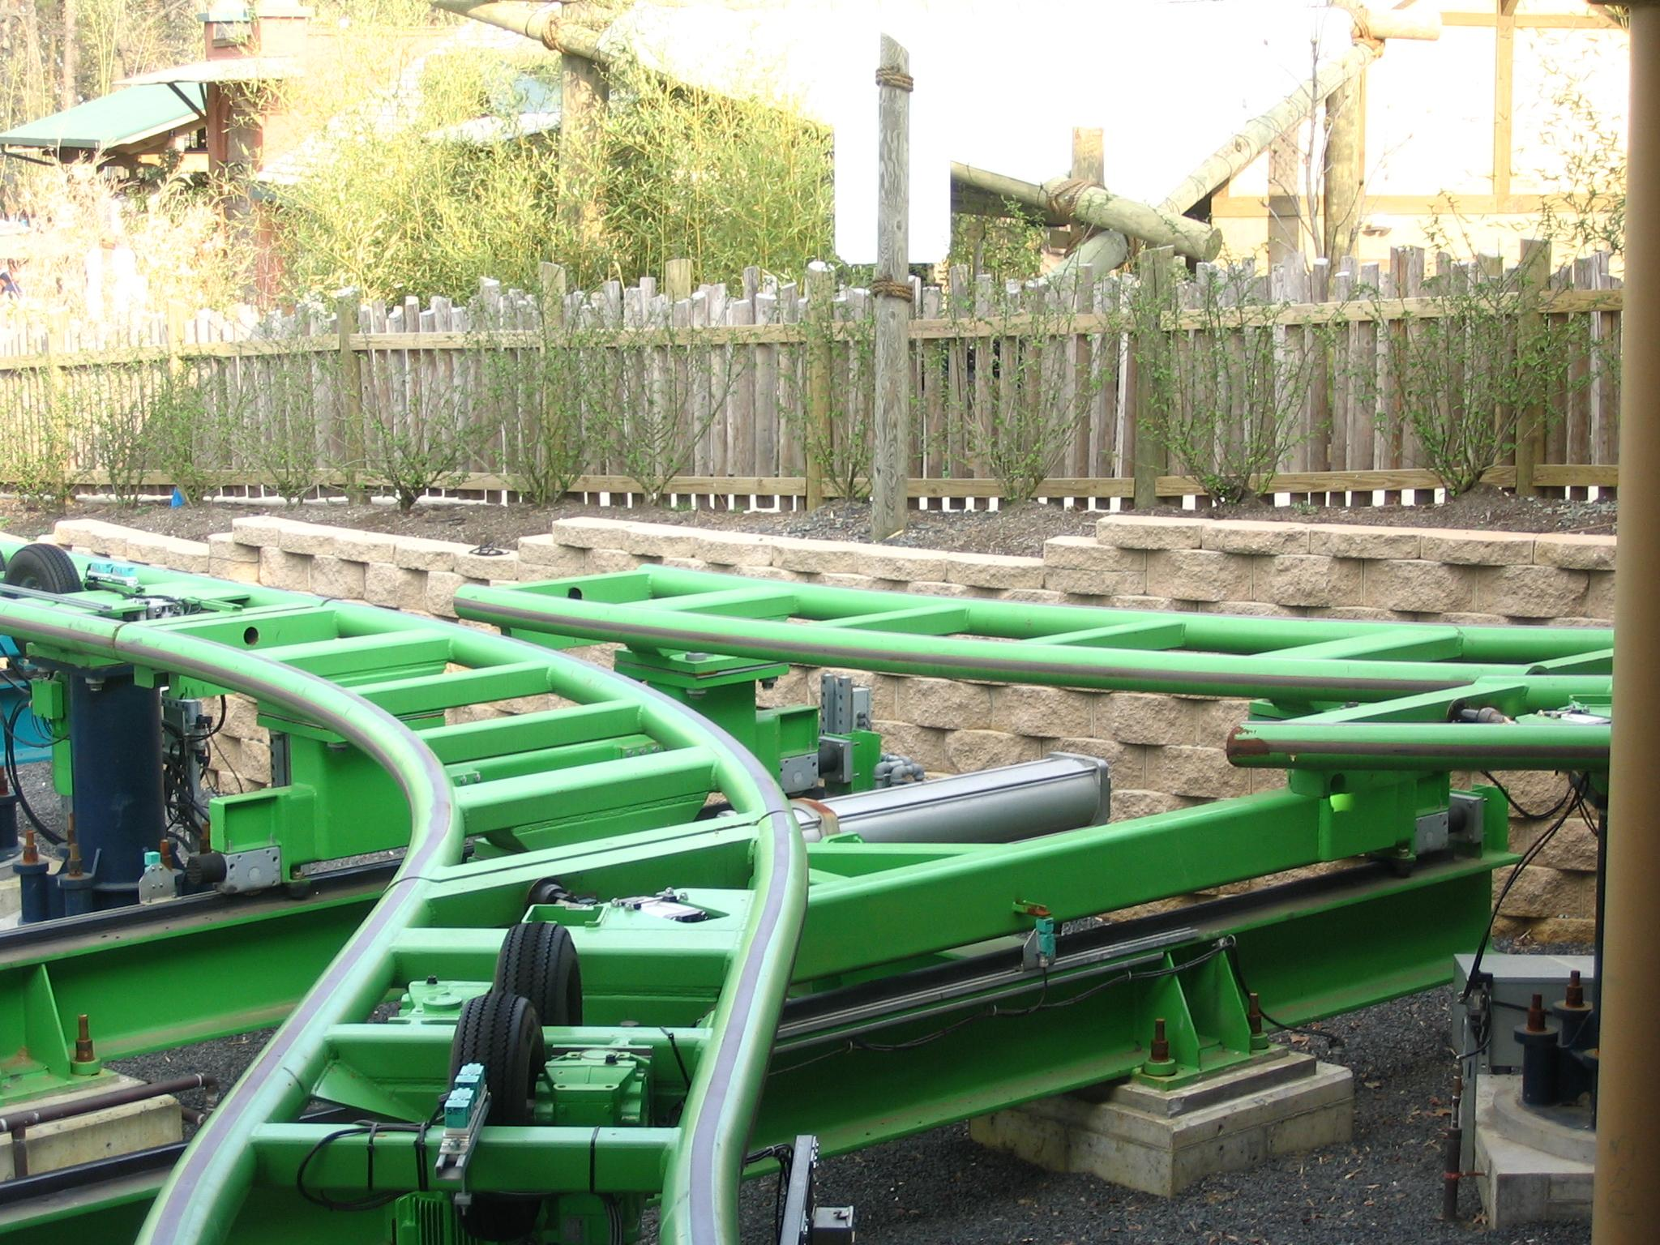
I believe I created a roller coaster that met my two main goals: be safe and be fun.
Notes:
I believe I created a roller coaster that met my two main goals: safe and fun. I think this ride would be very fun to ride, however, I’m not sure if I personally would enjoy the back to back loops. If i were to create another roller coaster, I would make more hills. I may add a few little ones and a couple more large ones that build anticipation as it rises up the hill. I would ensure each step of the way that safety remains the priority and that I do not get wrapped up in trying to make it fun. Thank you!

